Slide 1
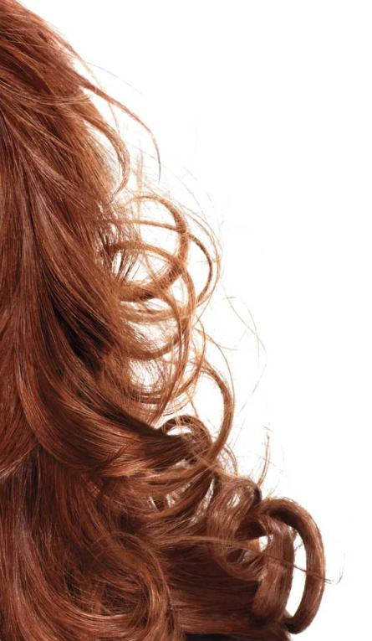


Hair Color 101

Slide 2
Today’s Goals
-Why women color their hair-
-Hair Color Theory-
-Product Knowledge-

Slide 3
What Women Want: When They Color their Hair
-A change
-To feel beautiful
-To feel understood
-Not to make a big mistake
-Great hair!

Slide 4
How You Can Help: Understand their needs
- Have you colored your hair before?
-Professionally or at home?
- What are your biggest issues with your hair?
-Damage?
-Grey?
-Dull?

Slide 5
How You Can Help: Understand their needs
- What results are you looking for
-Dramatic?
-Permanent?
-Natural?
- What are you most afraid of:
-Making a big mistake?
-A mess?
-Smell?

Slide 6
Hair Color Overview
Women love the transformative effect of hair color and how it refreshes their look instantly. Many professional looks and effects can now be achieved in-home with high quality L’Oreal products.
Some of the most popular looks and effects that people seek include:
-Covering gray hair
-Root touch-ups
-Trying a new shade for fun
-High gloss color treatments
-Highlighting

Slide 7
&
Learn Color Theory

Slide 8
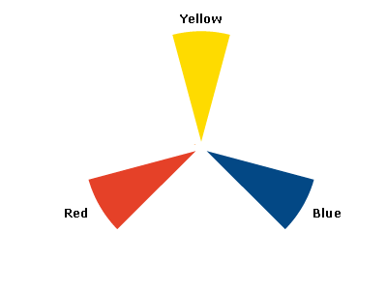
Primary Colors

Slide 9
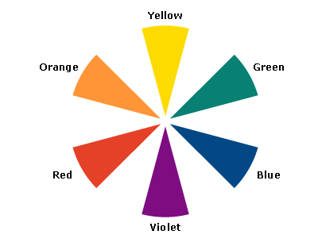
Secondary Colors

Slide 10
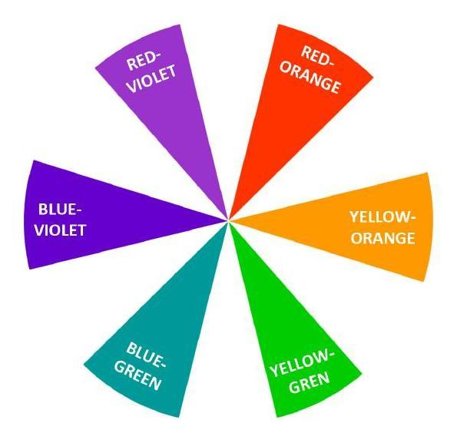
Tertiary Colors

Slide 11
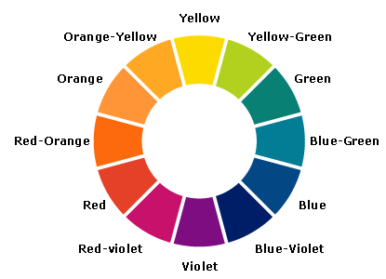
Full Color Wheel

Slide 12
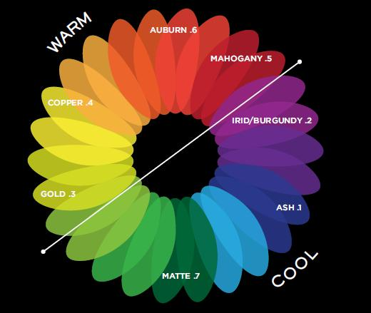
Hair Color Tones

Slide 13
Level System
-Hair color begins by identifying the "level" or darkness of the hair.
-This is used to describe how light or dark the hair color is.
-The level system eliminates consumer confusion and helps achieve predictable results across different brands and products.

Slide 14
Hair Color Levels & Categories
CATEGORY OF HAIR COLOR | LEVEL # | DESCRIPTION OF DEPTH
Blonde | 10 | Lightest Blonde
Blonde | 9 | Light Blonde
Blonde | 8 | (Medium) Blonde
Blonde | 7 | Dark Blonde
Brown | 6 | Light Brown
Brown | 5 | (Medium) Brown
Brown | 4 | Dark Brown
Brown/Black | 3 | Darkest Brown/Soft Black
Black | 2 | Brown Black
Black | 1 | Black

Slide 15
Hair Color Levels & Tones
-After establishing the level of one's natural or desired hair color, next the tone of hair color is defined.
-Tone refers to the “finish” of a shade—its degree of warmth or coolness.
-Categorized as warm, neutral or cool
-Usually part of the shade description (think terms like “gold” or “ash”).
-No matter your level of color, you can choose from a variety of tones to help you achieve your color transformation.
-When defining a hair color, the level and tone are combined into a letter/number combination.
-For example: a warm brown color would be defined as a "5W". The number indicates the hair color level (brown), and the letter indicates that the tone is warm.

Slide 16
Hair Color Tones
-ASH (Cool) - color which has no red or gold highlights/tones
-Will minimize red/gold/brassy tones
-NEUTRAL - color which has an equal amount of primary colors
-Balanced
-BEIGE & CHAMPAGNE - similar to a neutral, but may be more warm or cool, depending on base
-GOLD (Warm) - color which adds golden highlights/tones
-RED (Warm) - color which adds red highlights/tones

Slide 17
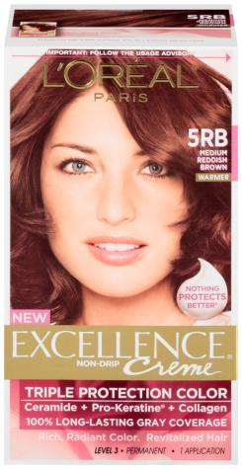
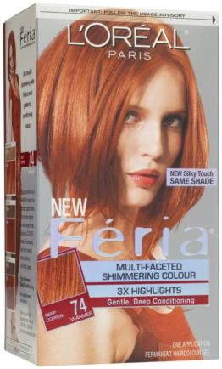
Decoding the Technical Numbers
-The number in the first position designates the level.
-The next number or letter is the primary tone of the shade.
-Letters can also be used to indicate the tone of the shade.
7.4
Deep Copper
5.6
Medium Reddish Brown

Slide 18
Hair Color Levels & Categories
CATEGORY OF HAIR COLOR | LEVEL # | DESCRIPTION OF DEPTH
Blonde | 10 | Lightest Blonde
Blonde | 9 | Light Blonde
Blonde | 8 | (Medium) Blonde
Blonde | 7 | Dark Blonde
Brown | 6 | Light Brown
Brown | 5 | (Medium) Brown
Brown | 4 | Dark Brown
Brown/Black | 3 | Darkest Brown/Soft Black
Black | 2 | Brown Black
Black | 1 | Black

Slide 19
Hair Color Tones

Slide 20
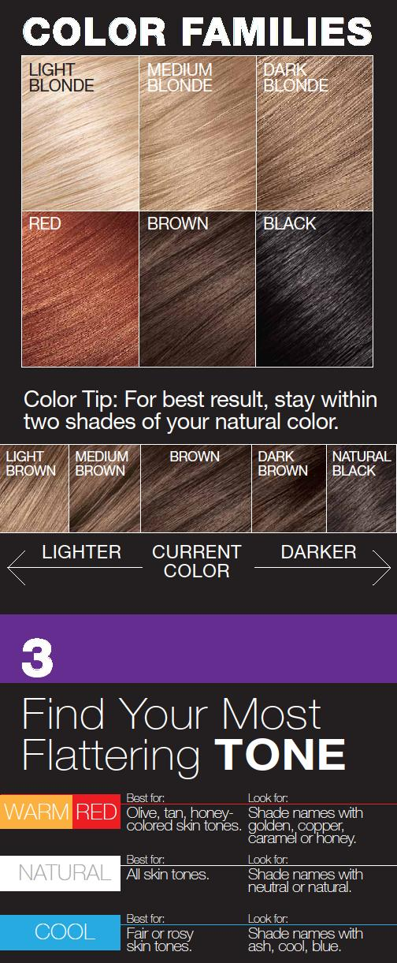
Hair Color FAQs
Q: How do I choose the right tones within a shade?
A:

Slide 21
Hair Color FAQs
Q: How do I choose the best shade, color, or level for myself?
A: Choose your desired shade family. For best result, stay within two shades of your natural color

Slide 22
Product Knowledge

Slide 23
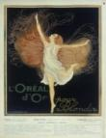


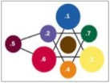

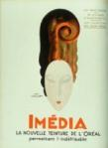
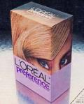



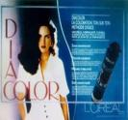
L’ORÉAL Timeline: THE Trailblazer in Hair Color
Formation of L’Oréal with the invention of hair color
L’Oréal creates the level system, the common language for hair color today
Launch of Excellence:
First crème at home hair color
First online diagnostic tool for hair color
The 1st Automatic, Reusable Haircolor
1907 | 1929 | 1952 | 1970 |  | 1990 | 1994 | 2003 | 2007 | 2010 | 2014 2015
First single-process hair color
Launch of Preference
First tone-on-tone technology developed
First 2-step at home hair color kit
First tone-on-tone crème
First haircolor developed for the mature consumer

Slide 24
Different Types of Hair Color
 | Semi-Permanent Hair color | Tone-on-Tone Hair color | Permanent Hair color | Special Effects
What does it do? | Washes out in 4 – 8 shampoos Matches natural color Deposits artificial pigment No visible regrowth | Washes out over time (28 shampoos) Respects natural pigment Deposits artificial pigment No visible regrowth | Permanently alters hair color Matches natural color OR creates dramatically different look Removes natural pigment Deposits artificial pigment Creates visible regrowth Must be grown out or cut out | Permanent alters hair color Removes pigment – natural and artificial Creates visible regrowth Must be grown out or cut out
Levels of Lift | Does not Lift | Some Lift, up to 1 Level | Lifts up to 3 Levels | Lifts up to 4 Levels

Slide 25
Semi-Permanent Hair Color
-When deciding to use semi-permanent hair color vs. permanent hair color, think about your desired result. Is it to blend away the first signs of gray or to enhance your natural hair color? If so, semi-permanent hair color may be the best choice.
-Semi-Permanent color deposits color without lightening and does not change your natural color pigment.

Slide 26
Permanent Hair Color
-Permanent Hair Color: If you want to cover grays, lighten your hair or make a more dramatic change, permanent hair color is most likely the best option for you.
-You can also make a subtle change with permanent color, but it will change the natural pigment of your hair and lasts longer than semi-permanent color.
-Keep in mind that as your hair grows out, you’ll need to dye your roots to match the rest of your hair.

Slide 27
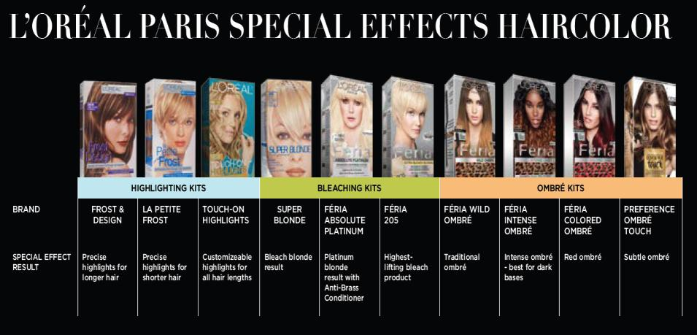

Slide 28






L’Oréal Brands:
Brand | Feria | Preference Mousse Absolue | Preference | Excellence | Excellence Age Perfect | Root Rescue
Role in Portfolio | Recruit the “Bold” Millenial And Fashion Forward Haircolorist | Increase share of Dual/Salon Users | Target Core of Haircolor Market with the widest range of premium shades | Own the Gray Coverage Consumer and Increase share of Boomers | Retain mature hair color users and Pre-abandonists | Increase share of Dual/Salon Users & In-between Colorers
Position | Color so multi-faceted, it shimmers. The end of dull, flat color | The 1st automatic, reusable haircolor. Absolute color perfection in just one push. | Luminous color that shines for up to 8 weeks. Over 50 shades | Nothing Covers Gray Better, Nothing Protects Betters Zero grays | Radiant color, full of highlights Harmoniously blended roots Transformed hair- replenished, volume, shine | Precise Root Touch Ups, in between colorings.
Benefits | Pure dyes 3 x Highlights | One push dispenser automatically mixes and keeps dyes fresh | Fade-Defying Color+Shine System | Triple Protection System with Pro-Keratine, Ceramide, & Collagen | The 1st layered tone flattering color specially developed for mature, gray hair | Shade Matching Guaranteed Quick Precision Applicator
Strategy | Vibrant shades, intense reflects, lighteners, trends | Edited range of sophisticated top sellers | Incomparable color variety, fundamentals with sophisticated reflects | Focus on natural base tones with 100% grey coverage | Delicately balanced natural warm shades, with highs & lows. Base 5 & up | Seamless, Permanent Color just where you need it.
Target | 18 – 44 | 30 – 55 | 30-54 | 40-65+ | 55+ | 35-65

Slide 29
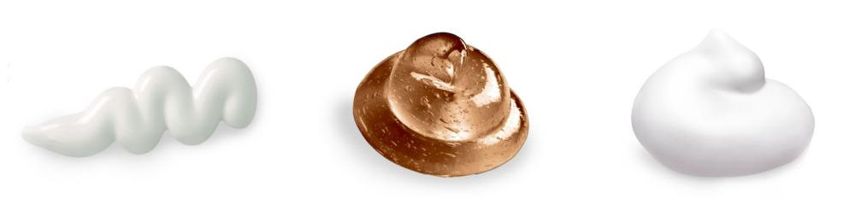
Different Forms of Hair Color
Crème
Thicker consistency
Maximum gray coverage
Works well on coarse, dry or fragile hair
Liquid/Gel
Easy to spread through hair
Natural gray coverage/new growth less noticeable
Works well on fine to medium hair
Mousse/Foam
Easy to apply as shampoo/no drip mousse formula
Perfect gray coverage
Works well on all hair types

Slide 30

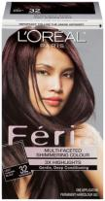
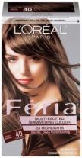
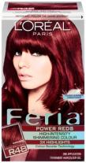
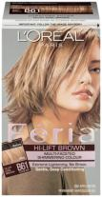
Féria
Brand Equity | Feria was launched in 1998 as the first fashion and trend driven hair color brand in the marketplace with a unique color positioning: multidimensional, shimmering color with 3X highlights, the end of dull and flat color. Since then it has become known as the edgiest and trendiest shade range within the L’Oréal Paris portfolio.
How the Product is Different | Each shade is custom blended to combine three vibrant tones for multi-dimensional color that really makes a statement Shades are inspired by cutting-edge fashion Féria has a low ammonia formula with built-in deep conditioners so hair is never wrecked or ravaged
Who Should Use the Product | Women who are looking for fashion-forward, head-turning color. Women with a low percentage of gray The Hispanic consumer especially loves Féria because the shades really pop on dark hair. Féria is known for having very unique and vibrant red and black shades
Top Claims | Multi-Faceted Shimmering Color 3X Highlights Gentle, Deep Conditioning Won’t Wreck or Ravage Hair

Slide 31

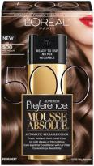
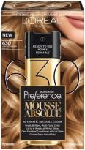
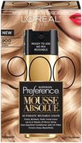
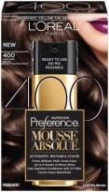
Mousse Absolue
Brand Equity | After 10 years of research, Preference Mousse Absolue reinvents at-home hair color as its advanced technology provides the first no-mixing, reusable hair color. With one push, the perfect ratio of color and activator crème is automatically mixed in an easy to apply mousse.
How the Product is Different | The first-ever automatic, reusable hair color No mixing needed- in just one push color is automatically blended into smooth foam Non-drip mousse allows for easy application even on hard to reach areas
Who Should Use the Product | Dual colorers (home & salon) and salon-only users. These consumers are more willing to pay more for a higher quality product.
Top Claims | Absolute color perfection in just one push. Fresh, brilliant, multi-tonal, color Up to 6 weeks of mirror shine Care Supreme Conditioner with UV Filter Covers grays beautifully

Slide 32

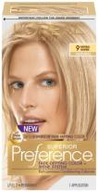
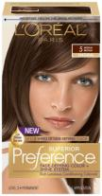
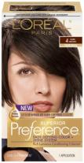
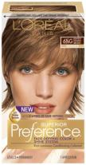

Preference
Brand Equity | Superior Preference is L’Oreal’s gold standard of beautiful color and shine. Preference launched in 1970 and was the first brand to introduce the “Because I'm Worth It” message via premium product and superiority. It has become L’Oreal’s #1 haircolor brand, and is the brand in our portfolio that has come to stand for elegance, sophistication and glamour.
How the Product is Different | Preference’s Superior Fade-Defying Color and Shine System creates a long-lasting color spectrum with luminosity, shine, and beautiful gray coverage. Luminous color shines from every strand and defies fade-out for up to 8 weeks. Care Supreme Conditioner formulated with Golden Camelina Oil, anti-oxidant Vitamin E and UV filter helps keep first day color vibrancy and provides silky, resilient hair.
Who Should Use the Product | Women looking for luminous, long-lasting color Women with low or high percentage of grey
Top Claims | Up to 8 weeks of fade-defying color Care Supreme Conditioner, formulated with Shine Serum, anti- oxidant Vitamin E, and UV Filter to help keep first day color vibrancy

Slide 33

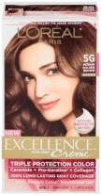
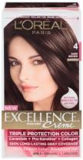
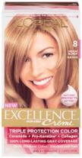
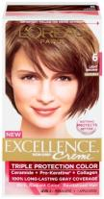
Excellence
Brand Equity | Excellence is the only triple protection hair color that gives women the richest color and the ultimate care. All with zero grays.
How the Product is Different | Only Excellence has a Triple Protection System which reinforces the internal structure of hair and helps protect it from damage. The results is rich, radiant, perfectly even color. The unique Pre-Color Serum with Ceramide penetrates each strand to protect fragile hair from damage before coloring. Exclusive Excellence Color comb and applicator allows you to apply color precisely and quickly.
Who Should Use the Product | Excellence is perfect for that woman who colors regularly but is looking the most protective and caring hair color that will not damage her hair. She is looking for that classic natural color that provides impeccable gray coverage.
Top Claims | 100% Long-Lasting Gray Coverage Rich, Radiant Color. Revitalized Hair Permanent hair color

Slide 34

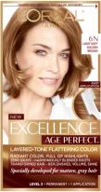
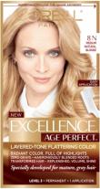
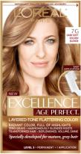
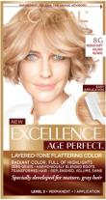
Age Perfect
Brand Equity | Excellence Age Perfect is a new product developed to meet the changing hair color needs of the 55+ woman, by using technology specifically developed for mature gray hair. The result is more flattering color, full of natural highs & lows for a layered tonal effect, as if the hair was highlighted. It provides gentle, restorative care that leaves hair looking healthy, full of volume and shine.
How the Product is Different | Specifically developed for mature hair using new grey technology. The 1st layered-tone flattering color for harmoniously blended roots The new formula addresses the consumer need for gray coverage that is more blended, less visible at the root, for a natural looking color that is more flattering to her skin tone
Who Should Use the Product | Women 55+ who are dealing with the challenges of maturing gray hair and are seeking more natural looking color and replenished hair full of volume and shine
Top Claims | Radiant color, full of highlights Zero greys- harmoniously blended roots Transformed hair- replenished, volume, shine New exclusive color brush for easy application

Slide 35





Root Rescue
Brand Equity | Root Rescue 10 Minute Root Coloring Kit was launched in 2010 as the next generation in the root touch-up market that merges color with care and convenience. With a breakthrough applicator, guaranteed shade matching and a conditioning formula, covering grays and roots has never been so precise or easy. Just mix and color your way to seamless coverage…all in just 10 minutes.
How the Product is Different | Revolutionary Quick Precision Applicator is a self-contained, root application tool that makes coloring quick, easy and precise. 10 minute formula: The root matching formula takes only 10 minutes to retouch color and to cover stubborn grays. Unique, low-ammonia formula with built-in conditioning and an aromatic scent 50% more product than the leading root touch-up competitor so no root is left behind
Who Should Use the Product | Women looking for a quick touch-up between full-color applications Salon users who are looking to extend their time between visits
Top Claims | Get seamless permanent color in just 10 minutes Seamless shade matching guaranteed Low ammonia formula with built-in conditioning and aromatic scent 100% gray coverage Quick Precision Applicator makes application fast, easy and precise

Slide 36




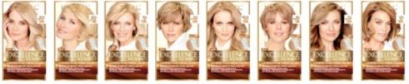











2015 Haircolor Innovation
GLAM LIGHTS
3 SKUs
AGE PERFECT
8 SKUs
FERIA POWERS
2 New; 4 Reno
SUMMER LIGHTS
2 SKUs

Slide 37




L’Oréal Paris Portfolio
Target | <40 | 35 - 50 | 40 - 55 | 55+
Consumer Motivation | The desire to feel trendy and fashionable by transforming the appearance of one’s hair. | The desire to stand out as beautiful by enhancing the appearance of one's hair | The desire to hide the physical signs of age through restoring youthful appearance of one’s hair | The desire to look the best possible for my age by maintaining the beauty of one’s hair
Color Strategy | Bold shades, itense reflects, lighteners, trends. | Incomparable color variety, fundamentals with sophisticated reflects | Focus on natural bases and subtle ones with 100% grey coverage | Delicately balanced natural warm shades, with highs & lows. Base 5 & up
USP | Multi-Faceted, Shimmering Color. Never Dull, Never Flat. | Luminous color that shines for up to 8 weeks. | Triple Protection for Color Perfection. Rich, radiant, zero greys. | The 1st layered tone flattering color specially developed for mature, gray hair
RTB | Pure dyes 3 x highlights | Care Supreme Conditioner | Triple Protection System | Layered Tone Technology
Role within Portfolio | Recruitment to color | Recruitment to permanent color All women who seek a subtle transformation and who want more than just reflects | Loyalty to color All women who want natural looking color with reassurance of 100% gray coverage | Retention to color Pre-abandonist 55+ women looking to minimize the vicious cycle
Artiste Translation | The art of trend & transformation | The art of lasting luminosity & expertly crafted color | The art of perfection in care & coverage | The art of flattering mature hair

Slide 38
HAIRCOLOR DO’S
DO
Do read the instructions and make sure you're fully prepared.
Do make sure you have haircare products for after you color service that protect, enhance, and prolong the life of your hair color.
Do treat your colored hair as you would your skin and protect it from the sun.
Do have a skin-color barrier for coloring hair and a hair color stain remover. A fun hack is a clear lip gloss to protect from staining. Also, to remove stains, eye makeup remover works great.

Slide 39
HAIRCOLOR DON’TS
DON’T
Don't forget that color does not lift color. That is why I suggest being realistic and taking small steps and not trying to go two shade lighter than your starting point.
Don't forget to time your hair color service on a timer or your phone, etc. to prevent early color removal or too long of color application--sounds basic but is often overlooked.
Don't forget if you have extremely thick or long hair and you're pulling your color through the ends, there is a possibility that you might need two color kits. You don't want to be caught without enough color.
Don't wear a your favorite designer clothing when coloring your hair. Designate a shirt that you do not care about for coloring your hair.

Slide 40
Color Touch Ups
Remember--
-Apply only to the roots (new growth).
-Processed hair grabs color quicker and you will end up with very dark hair at the tips and lighter at the roots if you apply the color all over.

Slide 41
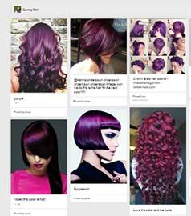
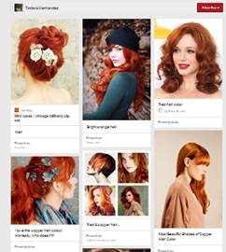
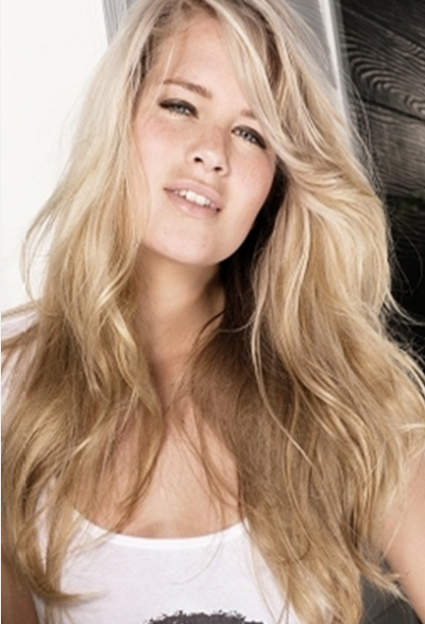
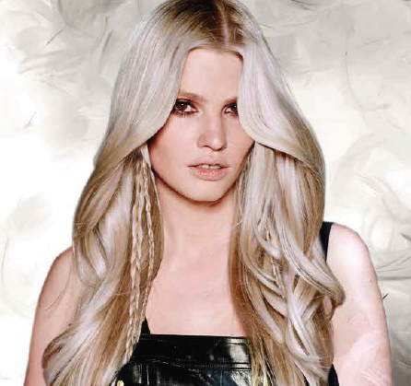
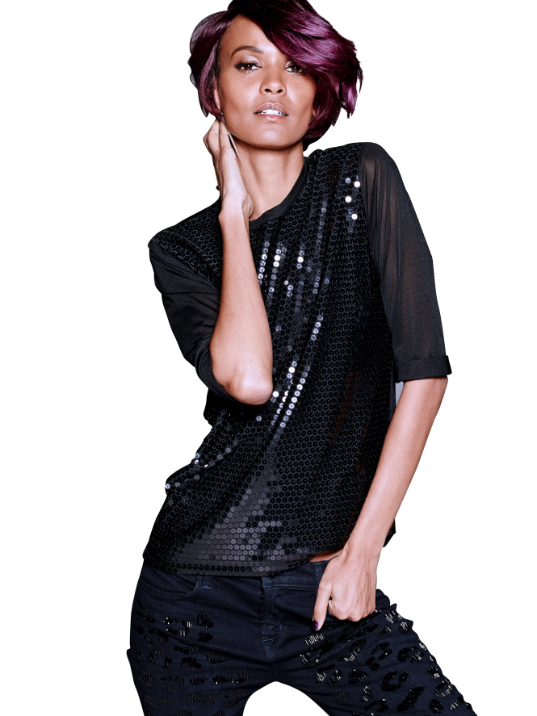
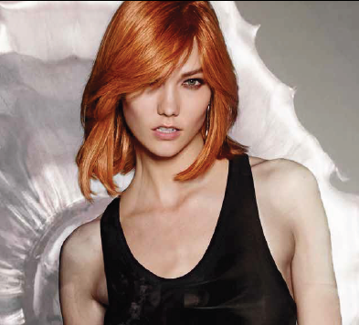
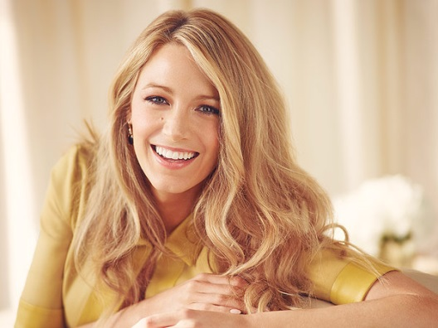
WHAT’S HOT; TREND SPOTTING!
Violet
Platinum,
Sun-kissed Blonde
Copper

Slide 42
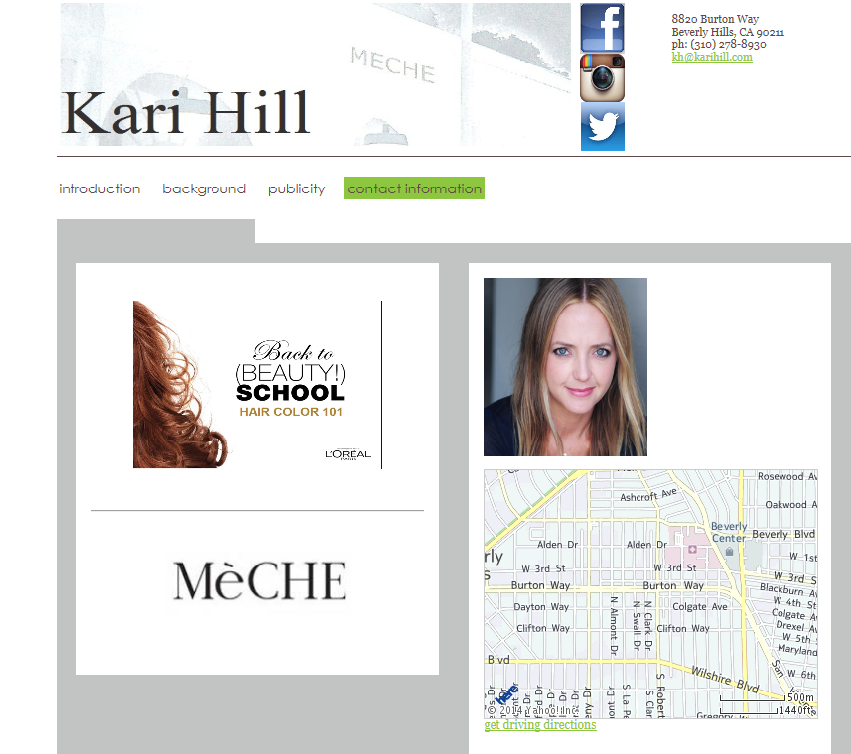
www.karihill.com Download Powerpoint

